Slide 1
firm Histories
A/P Medha Kudaisya

Slide 2
Lecture Outline
Why do Firms exist?
Firms in Business History.
Firm Histories: Cold Storage
Late 19th c. mechanization in food production
Early Years of Cold Storage, 1903-1910s
New Interests 1920s -1930s
Late 1930s-1940s: ‘Grocery store to super-market style food retailing’
Market Niches: Continuities and Changes

Slide 3
Why do Firms exist?
Why do we need firms? Why is everything not done by the Market?
Ronald Coase, The Nature of the Firm (1937)
Firms exists because going to the market all the time imposes heavy transaction costs
Firms internalise transactions inside their legal boundaries
Firms need to contain the costs of transacting in the market
A device for creating long-term contracts when short term contracts are too bothersome
Neo-Coasians:
Critique Coase for over emphasising transaction costs
Firms put together resources that markets cannot access
Organisational Advantages of firms
Corporate culture; collective knowledge
Organise production and create knowledge
Promote Innovation

Slide 4
The ‘Firm’ in Business History
Complex units that evolve over time
Differences in structures & internal dynamics
Firms: in the same industry usually share common characteristics
Firms are dynamic
Role of Technology in the firms expansion
Evolution of firms linked to cultural patterns and institutional elements of different societies

Slide 5
Cold Storage in Singapore: Late 19th c. Mechanization in Food Production
Modern Technologies and Food
Food Processing
Distribution for Mass Consumption
Rapid Improvement in Transportation
Changes in Agricultural production (1870s)
Standardized Food Products 1880s (large volume; small packages)
Increasing popularity of English breakfast & afternoon tea
Rising demand for manufactured food

Slide 6
Singapore in the early 20th c.
Singapore, 1906:
World’s 7th largest port in terms of tonnage
Electricity introduced
After 1906 electric lighting replaced manually operated fans
lighting and fans
1903: Cold Storage: symbol of ‘British imperial taste’

Slide 7
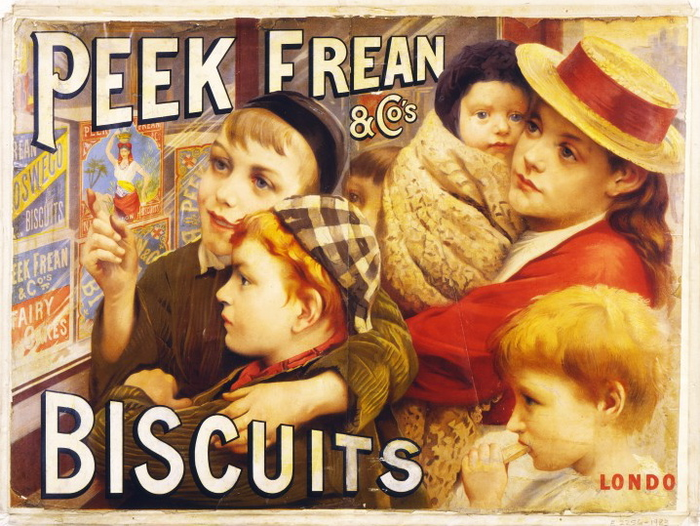
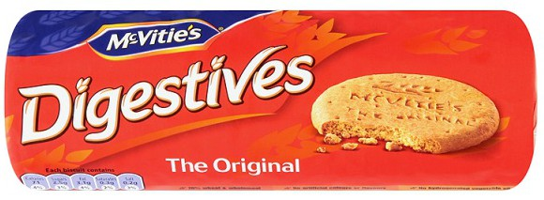
Firms & Brands in the 1880s

Slide 8

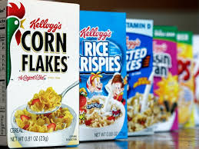
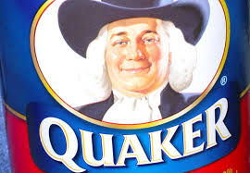
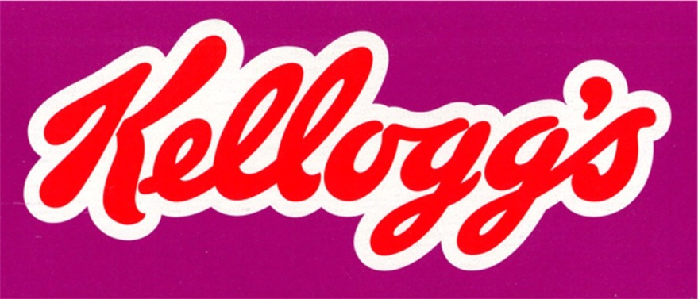
Firms and Brands, 1880s-1890s

Slide 9
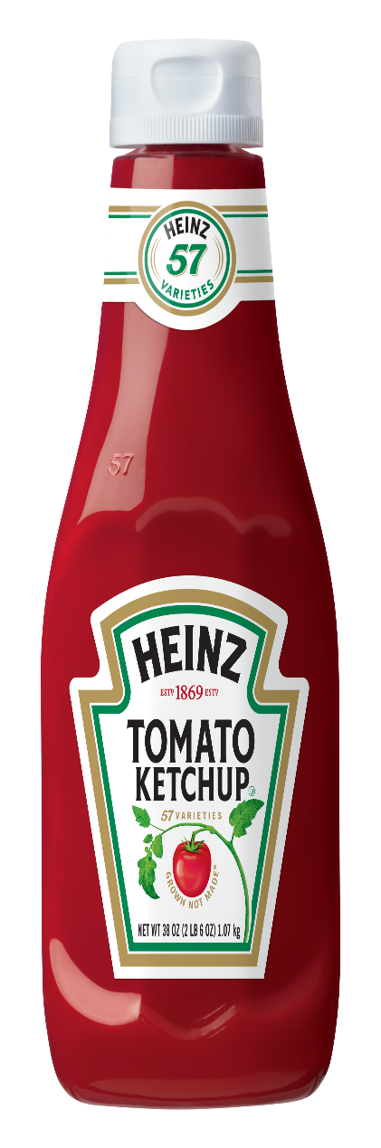
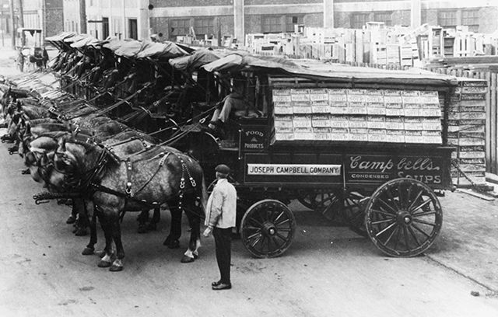
Firms and Brands, 1880s-1890s

Slide 10
Early Years of Cold Storage (I)
1903: Cold Storage registered : Deburgh Persee & H W H Stevans
Persee : Chairman, Raub Australian Gold Mining Co ltd.
Stevans : Manager of Victoria River Downs
Bought land in Borneo Wharf, Keppel Harbor: cold storage (2 insulated rooms, 200 tons refrigeration facility)
Retail operations, 1905: Orchard Road
frozen meats, poultry, dairy products imported from Australia
Pioneered processing & distribution of hygienic food supplies in Malaya

Slide 11
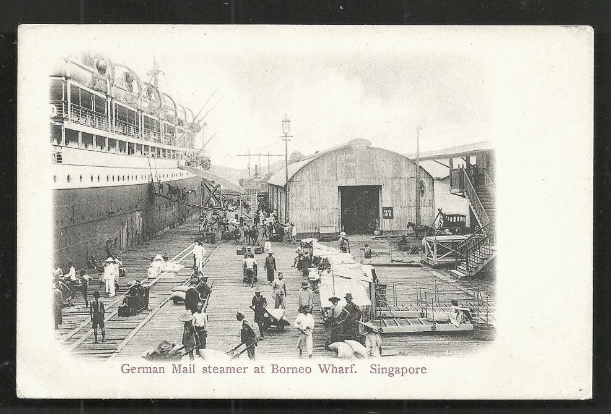

Slide 12
Straits Times 20 June, 1903:
‘The mere fact of obtaining a healthy and wholesome supply of animal food, fresh butter, poultry etc. of a quality about which there can be no doubt, is in itself a great inducement to become a shareholder ……a rump steak from an Australian bullock and a pat of fresh butter at breakfast time will freshen up the inner man and make us better fit for the troubles and worries of business hours.’

Slide 13
Straits Times 1910: The contents of the company’s stalls are essentially Australian, even the ornamentation….The decorations consist of pictures of Australian sheep farmers and cattle ranches and picturesque sheaves of wheat, barley, millet and other grains.’

Slide 14
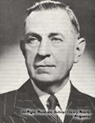
Early Years of Cold Storage, 1903-1930s (II)
Challenges in the Early Years
1909: new Management under Fred Haron
New retail outlets
1917: Orchard Road, Centre point
Main clients: British army & navy
Portrait of Mr. Fred R. Heron
Managing Director, Cold Storage
1909 to 1932

Slide 15
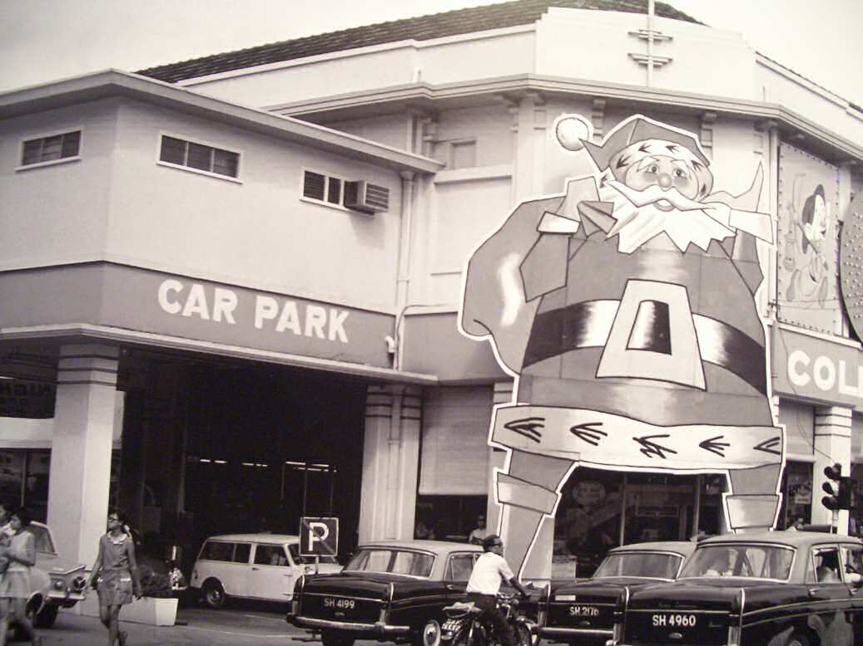
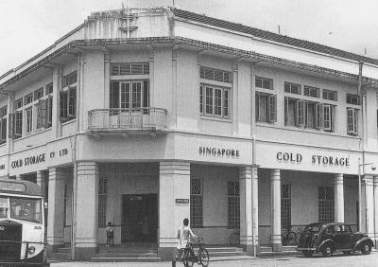
Cold Storage at Centre Point, Orchard Road

Slide 16
New Interests, 1920s - 1930s (I)
‘New Quality Foods’
Bread
Local Indian (Bengali) and Chinese bakeries
Acquired local bakeries (Royal Bakery, Geylang)
Milk
‘Imperial product’
Local dairies: Indians (Bengalis)
1905-1906 regulations and convictions because of adulteration
1930: Establishment of Diary Farm
Pig Farming
1930s: Impact of the Great Depression

Slide 17
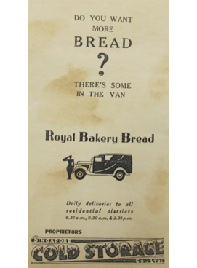
Acquiring Royal Bakery

Slide 18
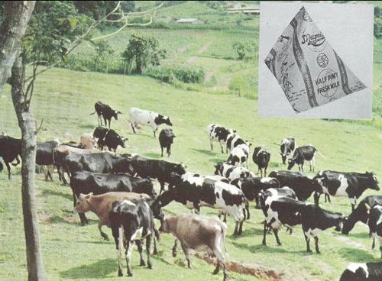
Foundation of Modern Milk Manufacturing Industry by Cold Storage
Advertisement 1930s: ‘Pure fresh milk from our own farm at Bukit Timah.
Our cows are the finest procurable, and they are kept in the most hygienic surroundings,
free form all dirt and contamination’ …
the company ‘makes no pretence of altering for the poorer classes’

Slide 19
New Interests, 1920s - 1930s (II)
Ice
Ice importation from the 1890s
1916: Ice Manufacturing Plant, Borneo Wharf
Ice factories, 1920s-1930s
Ice Cream Production
1923: Paradise Ice Cream
Cold Storage deal with Dan Miguel Brewery, Manila and set up Cold Storage Creameries Ltd
Cold Storage 55% of initial capital; 45% Dan Miguel
1937: Magnolia
Magnolia Snack Bar 1960s

Slide 20
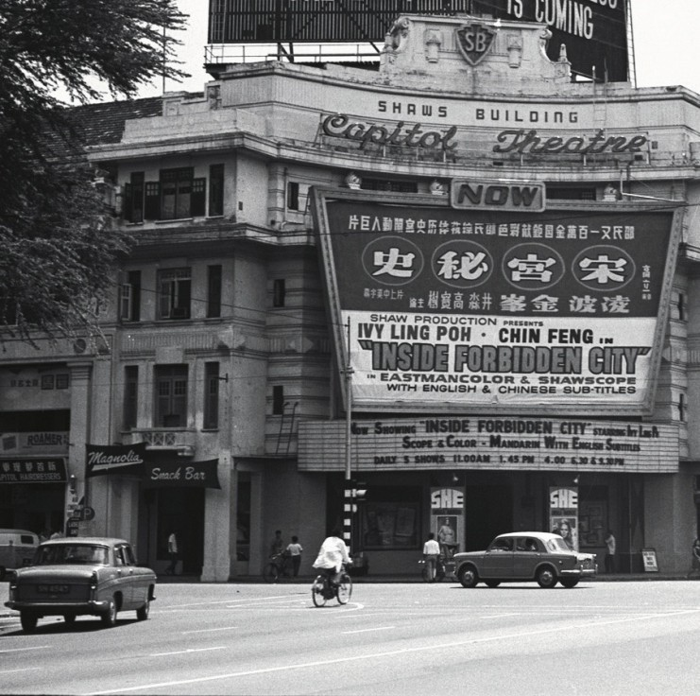
Magnolia snack bar, capitol theatre
1965

Slide 21
‘From Grocery Store to Super-Market Style Food Retailing’
Expansion in 1930s: Malacca, 1933, Seremban 1936, Cameron Highlands 1939
Local retail delivery, 1935
Varieties of products
Competitors
Store layout and design principles
Emphasis on the Exotic
‘Imperial Culture of Britishness’

Slide 22
Source: Goh Chor Boon, Serving Singapore. A Hundred Years of Cold Storage (Cold Storage)
Technology & Entrepot Colonialism in Singapore (ISEAS,2013)

Slide 23
Source: Goh Chor Boon, Serving Singapore. A Hundred Years of Cold Storage (Cold Storage)
Technology & Entrepot Colonialism in Singapore (ISEAS,2013)

Slide 24
Continuities
Cold Storage Today

Slide 25
Thank you

Slide 26
Early Years
Haji Mohamed Mustafa, Jaunpur, Uttar Pradesh
Muar, Malaysia: peddling food
1952: Singapore
Mushtaq, 1956: food business
Handkerchiefs

Slide 27
Entry into retail clothing 1965
1971: Campbell Lane (500 square feet space)
1973: Serangoon Road
New Interests
1985: take over pf shops for conservation
1986: new premises: Risks
Buying up of old shop houses
Retail space: 85,000 square greet
130 room hotel
1996: Retail space: 160,000 square feet

Slide 28
Retail Slump of mid 1990s
1997: Extended Mustafa Centre – S$25 million

